Slide 1

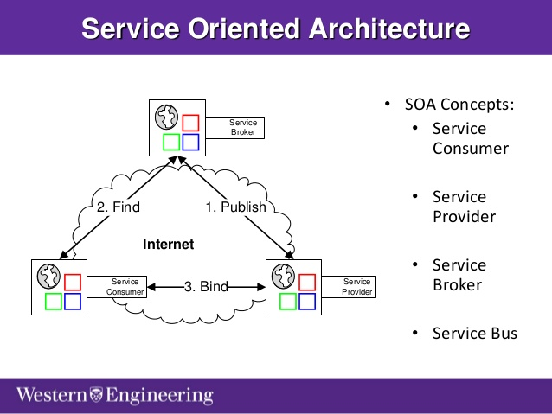
SOA(service oriented architecture)CO2
An SOA is a composition of services.
A “service” is the atomic unit of an SOA.
Services encapsulate a business process.
Service Providers Register themselves.
Service use involves: Find, Bind, Execute.

Slide 2
SOA(service oriented architecture)CO2
SOA is a style of software design where services are provided to the other components by application components, through a communication protocol over a network.
A service has four properties according to one of many definitions of SOA:
It logically represents a business activity with a specified outcome.
It is self-contained.
It is a black box for its consumers.
It may consist of many underlying services.

Slide 3
SOA(service oriented architecture)CO2
A manifesto was published for service-oriented architecture in October, 2009. This came up with six core values, as listed follows:
Business value is given more importance than technical strategy.
Strategic goals are given more importance than project-specific benefits.
Intrinsic inter-operability is given more importance than custom integration.
Shared services are given more importance than specific-purpose implementations.
Flexibility is given more importance than optimization.
Evolutionary refinement is given more importance than pursuit of initial perfection.

Slide 4
SOA benefits(CO2)
Language Neutral Integration: Regardless of the developing language used, the system offers and invoke services through a common mechanism.
Component Reuse: Once an organization built an application component, and offered it as a service, the rest of the organization can utilize that service.
Organizational Agility: SOA defines building blocks of capabilities provided by software and it offers some service(s): which can be recombined and integrated rapidly.
Leveraging Existing System: This is one of the major use of SOA which is to classify elements or functions of existing applications and make them available to the organizations or enterprise.

Slide 5
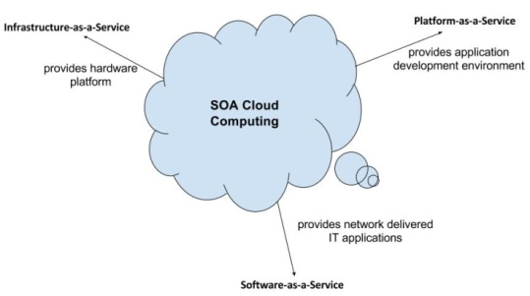
SOA benefits(CO2)
Business Benefits
Focus on Business Domain solutions
Leverage Existing Infrastructure
Agility
Technical Benefits
Loose Coupling
Autonomous Service
Location Transparency
Late Binding

Slide 6
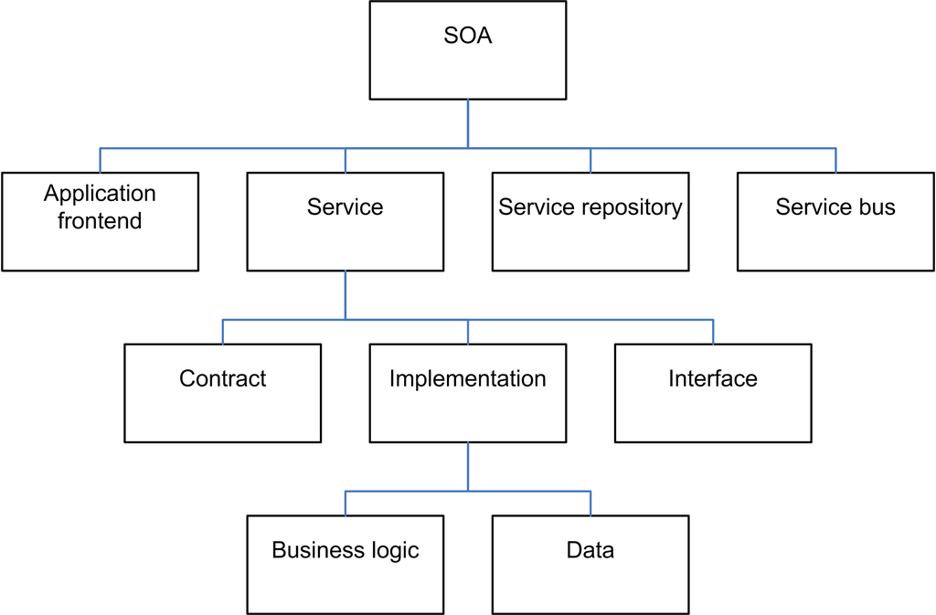
SOA(CO2)
Elements of SOA and its Architecture:

Slide 7
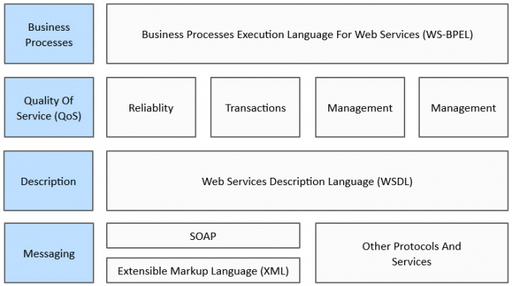
SOA(CO2)
Protocols in SOA and relationship between them:

Slide 8
SOA(CO2)
WSDL is an XML-based information exchange in decentralized and distributed environments.
WSDL definitions describe how to access a web service and what operations it will perform.
WSDL is a language for describing how to interface with XML-based services.
SOAP (Simple Object Access Protocol) is a messaging protocol specification for exchanging structured information in the implementation of web services in computer networks.
Its purpose is to provide extensibility, neutrality and independence.
It uses XML Information Set for its message format, and relies on application layer protocols, most often HTTP or SMTP, for message negotiation and transmission.

Slide 9
REST(CO2)
REST (Representational State Transfer) is usually referred as an architectural style rather than a protocol, which is used to build web services.
REST architecture allows the communication between two software programs.
In REST, one program can request and manipulate resources from the other one.
These requests can use data format including XML, HTML and JSON.
REST is developer-friendly because its simpler style makes it easier to implement and use than SOAP.

Slide 10
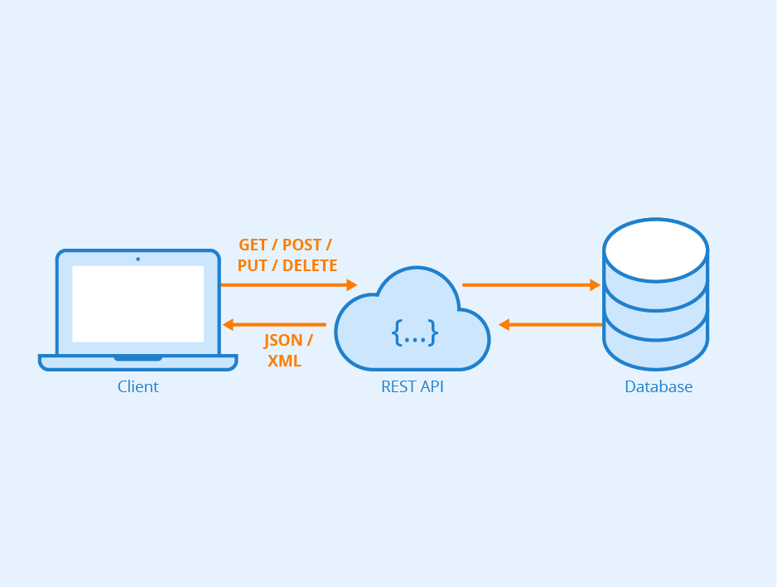
REST(CO2)
REST is less verbose, and less volume of data is sent when communicating between two endpoints.
In REST Architecture everything is a resource.
RESTful web services are light weight, highly scalable and maintainable and are very commonly used to create APIs for web-based applications.

Slide 11
Difference between Web services and REST(CO2)
REST
REST can be considered a postcard that has an URI as destination address, is lightweight.
REST is data-driven and is primary used to access a resource (URI) for certain data.
REST provides flexibility in choosing data format (plain text, HTML, XML, or JSON)
Web Services
SOAP is like using an envelope that contains lots of processing information inside it.
SOAP is a protocol that is function-driven.
SOAP only uses XML.

Slide 12
(Cont…)
REST
REST uses HTTP and can have address communication failures .
It can be solved by retrying however the retry logic doesn’t come in-built with REST.
Web Services
SOAP comes with enterprise-level security features supported by WS-Security, along with SSL support.
SOAP also provides in-built retry logic for guaranteed success and reliable communication.

Slide 13
Virtualization(CO2)
Virtualization is a technique for creating and providing virtual environment without affecting other users’ applications.
Virtualization is a technology that allows hardware to be isolated into different parts.
Virtualization allows to run multiple operating systems on a single system as virtual machines.
Each copy of an operating system is installed in to a virtual machine.
The basis of this technology is the ability of a computer program—or a combination of software and hardware—to emulate an executing environment separate from the one that hosts such programs.

Slide 14
Virtualization(CO2)
In a virtualized environment there are three major components:
Guest
Host
Virtualization layer.
The guest represents the system component that interacts with the virtualization layer rather than with the host, as would normally happen.
The host represents the original environment where the guest is supposed to be managed.
The virtualization layer is responsible for recreating the same or a different environment where the guest will operate.

Slide 15
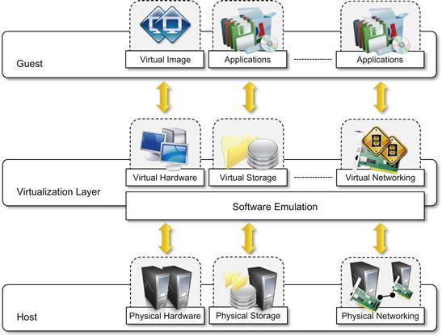
Virtualization(CO2)

Slide 16
Virtualization(CO2)
BENEFITS OF VIRTUALIZATION:
1. More flexible and efficient allocation of resources. 2. Enhance development productivity. 3. It lowers the cost of IT infrastructure. 4. Remote access and rapid scalability. 5. High availability and disaster recovery. 6. Pay per use of the IT infrastructure on demand. 7. Enables running multiple operating system.

Slide 17
Virtualization(CO2)
Virtualization techniques:
Partial Virtualization
Full Virtualization
Containerization
Para Virtualization
Partial Virtualization: If entire operating systems cannot run in the virtual machine, but some or many applications can, it is known as Partial Virtualization.
Ex: address space virtualization: Each virtual machine consists of an independent address space.

Slide 18
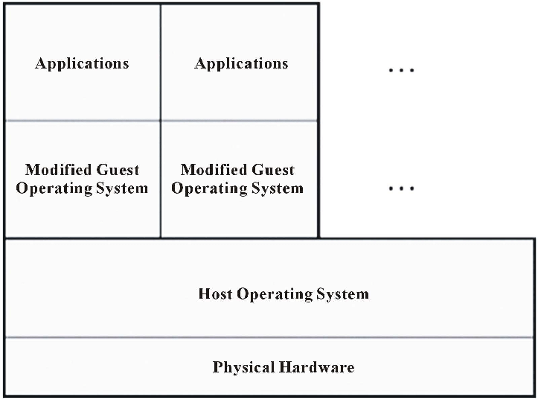
Virtualization(CO2)
Partial Virtualization:

Slide 19
Virtualization(CO2)
Full Virtualization:
In full virtualization, the VM simulates enough hardware to allow an unmodified guest OS to be run in isolation.
With full virtualization, all the files for the entire operating system exist within each VM.
Containerization is an even denser version of virtualization. It takes an entire operating system and condenses it down to one file.
A container is a VM that exists as a separate OS from the host OS but it only has the files that are unique to it i.e. it removes redundancy.

Slide 20
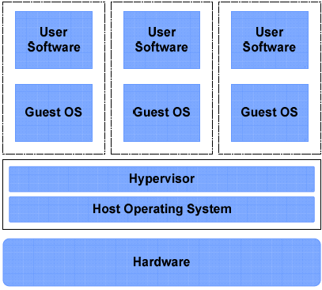
Virtualization(CO2)
Full Virtualization:

Slide 21
Virtualization(CO2)
Paravirtualization: A guest operating system (guest OS) is modified prior to installation inside a virtual machine (VM) in order to allow all guest OS within the system to share resources and successfully collaborate, rather than attempt to emulate an entire hardware environment.
Virtual machines can be accessed through interfaces that are similar to the underlying hardware.
Emulation is the use of one device to mimic the function of another device.

Slide 22
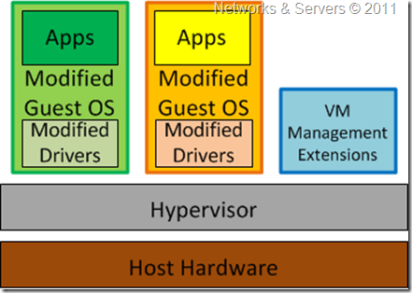
Virtualization(CO2)
Para Virtualization:

Slide 23
Types of Virtualization(CO2)
Hardware virtualization also known as hardware-assisted virtualization.
An individual independent segment of hardware (may be made up of multiple smaller hardware segments or servers) consolidates multiple virtual hardware's that run on a single primary physical Hardware.
Software Virtualization involves the creation of an operation of multiple virtual environments on the host machine.
It creates a computer system complete with hardware that lets the guest operating system to run.

Slide 24
Types of Virtualization(CO2)
Operating System Virtualization – It is also called OS-level virtualization is a type of virtualization technology which work on OS layer.
Application Virtualization – hosting individual applications in a virtual environment separate from the native OS
Service Virtualization – hosting specific processes and services related to a particular application.
Storage virtualization is a system administration practice that allows decoupling the physical organization of the hardware from its logical representation.
Multiple physical storage devices are grouped together, which then appear as a single storage device.
Partitioning your hard drive into multiple partitions is an example of this virtualization.

Slide 25
Types of Virtualization(CO2)
In network virtualization, multiple sub-networks can be created on the same physical network, which may or may not is authorized to communicate with each other.
e.g. With 588514304 addresses(reserved ipv4 addresses), 4294967296 or 2 ̂ 32 total ipv4 addresses are managed through address masking.
Desktop Virtualization:
This is perhaps the most common form of virtualization for any regular IT employee.
The user’s desktop is stored on a remote server, allowing the user to access his desktop from any device or location.

Slide 26
Types of Virtualization(CO2)
CPU virtualization: It involves a single CPU acting as if it were multiple separate CPUs.
The most common reason for doing this is to run multiple different operating systems on one machine.
I/O device virtualization is based on a one-to-many approach.
The path between a physical server and nearby peripherals is virtualized, allowing a single IT resource to be shared among virtual machines (VMs).
Recent Peripheral Component Interconnect Express (PCIe) virtualization standards include single root I/O virtualization (SR-IOV) and multi-root I/O virtualization (MR-IOV).

Slide 27
Virtualization(CO2)
Features of Virtualization:
Sharing: Virtualization allows the creation of a separate computing environment within the same host.
Aggregation: A group of separate hosts can be tied together and represented to guests as a single virtual host.
Emulation is the use of one device to mimic the function of another device. Old and legacy software that does not meet the requirements of current systems can be run on emulated hardware without any need to change the code.
Isolation. Virtualization allows providing guests—whether they are operating systems, applications, or other entities—with a completely separate environment, in which they are executed.
Notes:
Emulation: Running an OS on a hardware platform for what it has not originally engineered.

Slide 28
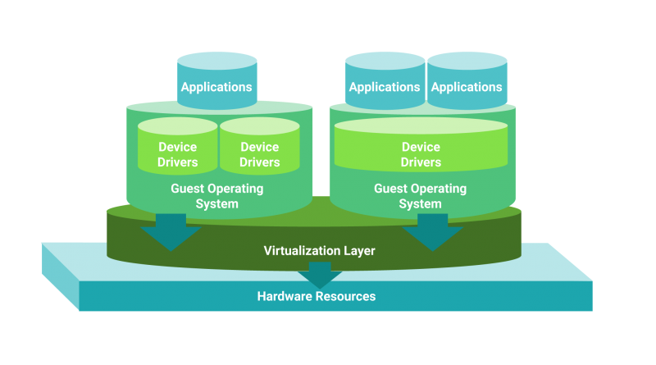
Virtualization(CO2)

